Slide 1

Discovering Common Molecular Pathways Between SARS-CoV-2 and Alzheimer’s Disease
Team members:
Inji Hatem Amin ID:231000596
Amira Momtaz Mohamed ID:231001071
Rowan Atef Nour Eldin ID:231001403
Youssef Rabeay Younes ID:231001982
Supervised by: PHD. Muhammed Mahmoud Elsayeh
CBIO311_CBIO310
Notes:
1

Slide 2

A Global Health Intersection: Unraveling the Neurological Aftermath
With over 750 million reported cases, SARS-CoV-2 has left a profound mark on global health. A significant concern is the approximately 30% of COVID-19 patients experiencing persistent neurological symptoms, hinting at a deeper connection to neurodegeneration. This intersection prompts critical questions about long-term neurological health outcomes.
Notes:
2

Slide 3
Hypothesis: Shared Pathways in COVID‑19 and Alzheimer’s Diseas
We hypothesized that a small set of common DEGs could be shared between the two conditions
These genes were expected to be involved in inflammatory and metabolic pathways (cytokine regulation, folate metabolism, mitochondrial function, NF‑κB signaling).
The convergence of several DEGs across these pathways would provide evidence for a molecular intersection.
Such overlap could amplify inflammatory stress and metabolic dysfunction, accelerating neuronal damage and cognitive decline.
Identifying multiple shared DEGs may highlight potential therapeutic targets addressing both immune activation and neurodegeneration.

Slide 4
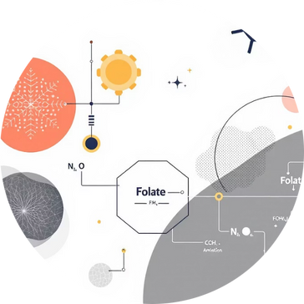
Methodology
COVID-19 & Alzheimer’s
Aim: Explore shared disruptions pathways between COVID-19 & Alzheimer’s.
Data: GSE164332 (COVID-19), GSE122063 (Alzheimer’s).
DEGs: |log₂FC| > 1.1, adj. p < 0.05.
Pathways: KEGG enrichment, validated with Enrichr & pathview.
Notes:
5

Slide 5
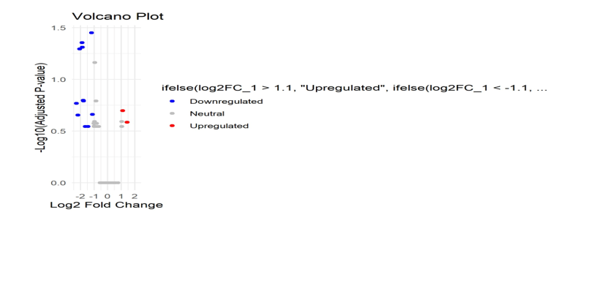
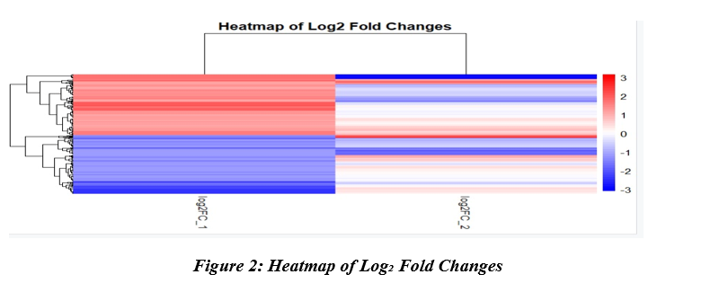
Results & Figures
Upregulated: Hippo signaling, Apoptosis
Downregulated: Oxidative Phosphorylation, Alzheimer’s pathways
Volcano plot: Red = up, Blue = down
Heatmap: Red = high, Blue = low expression
Conclusion: Shared transcriptional signatures; COVID-19 may affect neurodegeneration
Notes:
6

Slide 6
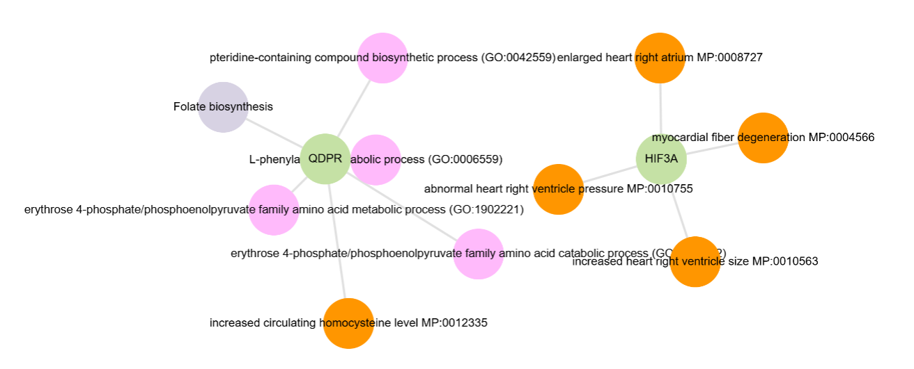
GSEA (Gene Set Enrichment Analysis)
GSEA used to determine if a predefined group of genes shows statistically significant

Slide 7
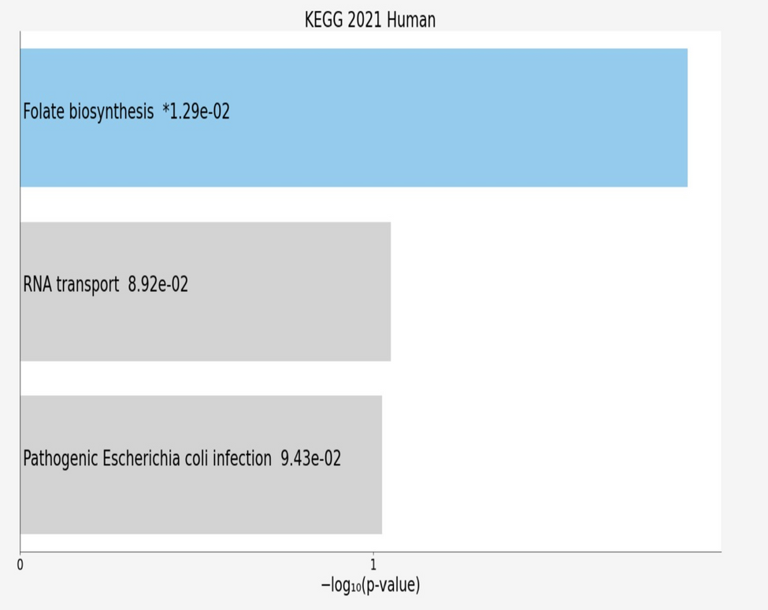
KEGG 2021 Human Pathway Enrichment
1.Folate biosynthesis
Identified as the most relevant pathway in the analysis
Linked to DNA synthesis, repair, and neuroinflammation
2.RNA transport
Showed weaker enrichment
Reflects general regulation of gene expression and cellular stress responses
3.Pathogenic Escherichia coli infection
Showed weaker enrichment
May indicate immune activation but not a core shared pathway

Slide 8
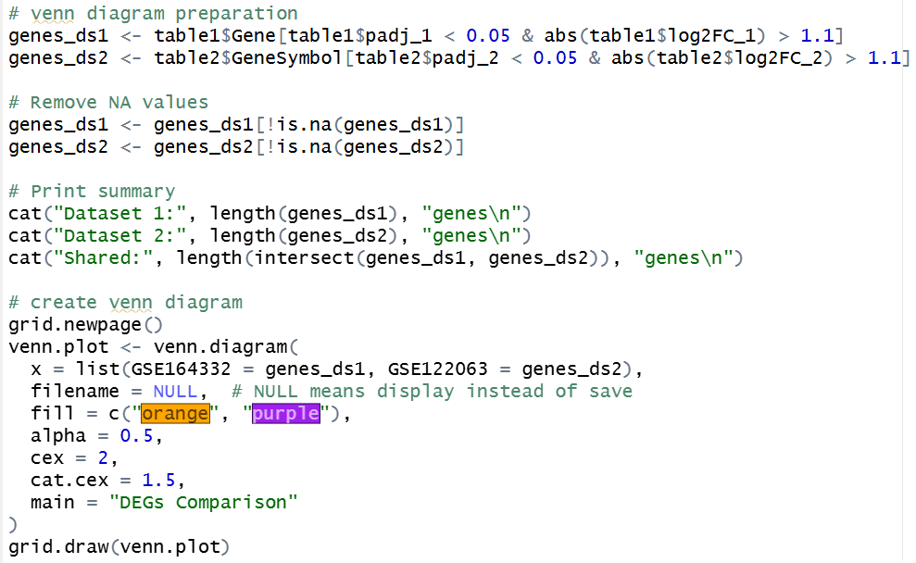
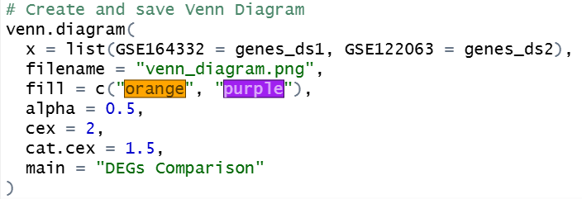
Venn Diagram Code & Plot
Purpose:
Identify differentially expressed genes (DEGs) in two datasets.
Visualize overlap and unique genes between studies.
Filtering Criteria:
Adjusted p-value < 0.05 (statistically significant).
|log2 Fold Change| > 1.1 (biologically meaningful).
Code Functions:
Data extraction - Filter significant genes from both datasets
Quality control - Remove missing values (NA)
Summary statistics - Count DEGs in each dataset and shared genes

Slide 9
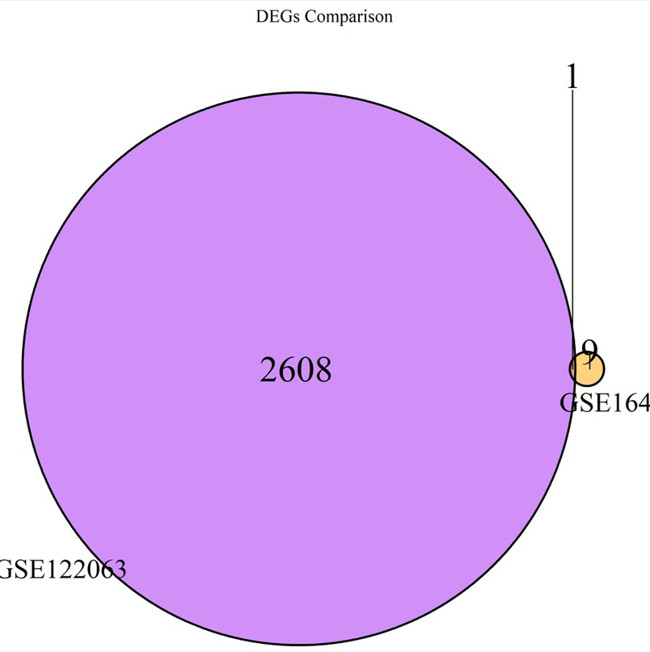
Venn Diagram Code & Plot
Output Interpretation:
Left region: Genes unique to Dataset 1.
Right region: Genes unique to Dataset 2.
Center region: Common DEGs (potential
core biomarkers).

Slide 10
NCL And it’s association with Covid & AD
The one shared and common DEG between both diseases is NCL (Nucleolin).
In Covid, it’s known for activation of inflammatory signaling cascades.
In AD, it’s associated with dysregulated neuroinflammation.
Why NCL is a significant biomarker?
Common pathway: Both diseases involve chronic inflammation and cellular stress
Neuroinflammation: Links systemic inflammation (COVID) to neurodegeneration (AD)
Dual role: Indicates both acute viral stress and chronic neurodegenerative changes

Slide 11
Thank You...

